Slide 1
Aaron Hartman MD MAR, FAAFP, DABFM, DABIM, DAIHM, IFMCP

Slide 2
www.RVAIntegrative.com

Slide 10
Fainting Spells & Hysteria
Neurasthenia
Central nervous system exhaustion resulting from modern civilization.
Teddy Roosevelt

Slide 11
Epidemic neuromyasthenia
Thought to be post polio syndrome
Benign myalgic encephalomyelitis
Psychologic phenomena
Chronic Fatigue Syndrome
1987 CDC consensus

Slide 12
Chronic widespread pain
Muscular Rheumatism
Fibrositis
Psychogenic Rheumatism
Neurasthenia
1987 — Journal of the American Medical Association
Coined term “Fibromyalgia” (controversial at the time)

Slide 14
Definition
A group of signs and symptoms that occur together and characterize a particular abnormality or condition
A set of concurrent things (such as emotions or actions) that usually form an identifiable pattern

Slide 15
Purpose in Medicine
Create a definable set of variables that can then be researched and explored by the medical community.
Once the definition is made, this enables scientists around the world to begin to research it and clinicians to diagnose it.

Slide 16
Examples
Down’s Syndrome » Now Trisomy 21
Irritable Bowel Syndrome »
1992 …
1999 …
2006 …
2016 …

Slide 17
ACR Criteria
widespread pain index >= 7 & symptom scale >= 5
widespread pain index >= 5 & symptom scale >= 9
Symptoms present at similar level for at least 3 months
No disorder otherwise explains the pain
OR
AND
AND

Slide 18
ACR Criteria: Widespread Pain Index
widespread pain index >= 7 & symptom scale >= 5
widespread pain index >= 5 & symptom scale >= 9
Symptoms present at similar level for at least 3 months
No disorder otherwise explains the pain
Note the number areas in which the patient has had pain over the last week.
In how many areas has the patient had pain? Score will be between 0 – 19.
OR
AND
neck | 6. left upper arm | 11. abdomen | 16. left upper leg
2. left jaw | 7. right upper arm | 12. upper back | 17. right upper leg
3. right jaw | 8. left lower leg | 13. lower back | 18. left lower leg
4. left shoulder girdle | 9. right lower leg | 14. left hip | 19. right lower leg
5. right shoulder girdle | 10. chest | 15. right hip
AND

Slide 19
ACR Criteria: Symptom Scale Score
widespread pain index >= 7 & symptom scale >= 5
widespread pain index >= 5 & symptom scale >= 9
Symptoms present at similar level for at least 3 months
No disorder otherwise explains the pain
The Symptom Scale Score is the sum of the severity of the three symptoms (fatigue, waking unrefreshed, cognitive symptoms) plus the extent of somatic symptoms in general. The final score is between 0 – 12
OR
AND
Fatigue (0 – 3)
Waking unrefreshed (0 – 3)
Cognitive symptoms (0 – 3)
General somatic symptoms (0 – 3)
0 = no problem
1 = slight or mild problems, generally mild or intermittent
2 = moderate, considerable problems, often present and/or at a
moderate level
3 = severe, pervasive, continuous, life-disturbing problems
AND

Slide 20
New Name: Systemic Exertion Intolerance Disease
Definition
A substantial reduction or impairment in the ability to engage in pre-illness levels of occupational, educational, social, or personal activities that persists for more than six months and is accompanied by fatigue, which is often profound, is of new or definite onset (not lifelong), is not the result of ongoing excessive exertion, and is not substantially alleviated by rest.

Slide 21
New Name: Systemic Exertion Intolerance Disease
Symptoms
Post-exertional malaise
Unrefreshing sleep
At least one of the following: cognitive impairment, orthostatic intolerance
Rule out Idiopathic Chronic Fatigue and others (ie Narcolepsy) though it may actually be a subset of CFS

Slide 24
Coexisting Disorders
Irritable Bowel Disease
TMJ
Tension/Migraine Headaches
Interstitial Cystitis
Vulvodynia
Psychiatric disorders (anxiety/depressions/PTSD)
Sleep disorders with chronic fatigue (within this arena CFS sits)
Inflammatory Rheumatologic Diseases (RA, Psoriatic Arthritis, Sjogren’s Syndrome, SLE)

Slide 25
Neuroinflammatory disorder of microglial cell activation
Explains relationship to coexisting disorders
Explains diverse manifestations of FM
No current “standard of care” takes this into account
Every individual treatment plan has to be personalized based on patients history, physical exam, laboratory findings & reaction to treatment strategies.
Chronic Fatigue exists as a subset of patients with disordered, non-restorative sleep resulting in ‘energy crisis’
Systemic Symptoms may represent disordered HPAG Axis function

Slide 26
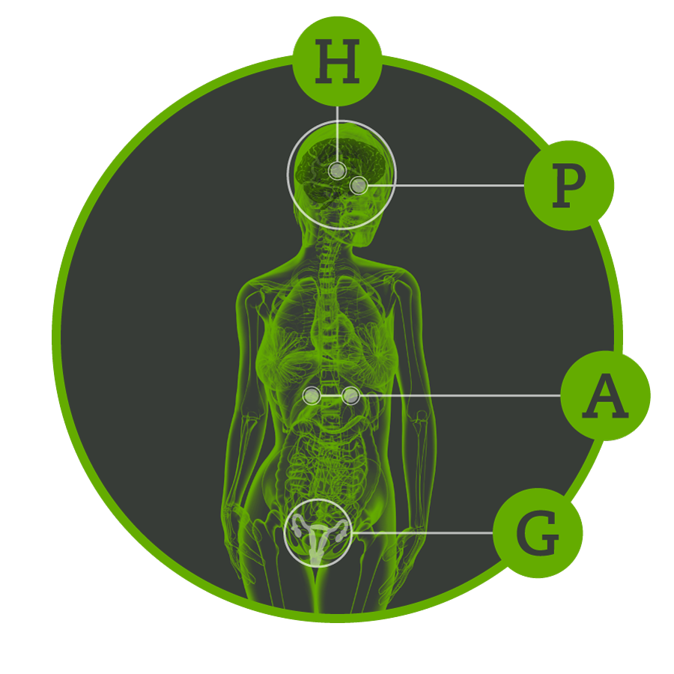
Hypothalamus
Pituitary
Adrenal
Gonadal

Slide 27
Recognizing the HPAG axis of dysfunction changes our way of thinking about the diverse symptoms associated with FM
exhaustion
achiness
weight gain
brain fog
increased thirst
low blood pressure
blood pressure fluctuations
sexual dysfunction
disordered sleep
non-restorative sleep
bowel dysfunction
irregular hormone levels
irritability
mood swings/depression/anxiety recurrent infections
pain/tactile sensitivity

Slide 29
Thorough Medical History & Physical Exam
Thorough Laboratory Evaluation
Complete Blood Count
Comprehensive Metabolic Panel
Thyroid levels (including TSH, FT4, FT3, RT3, thyroid antibodies)
Inflammatory markers and autoimmune markers (ESR, CRP, ANA, RF, ferritin, thyroid antibodies, celiac panel)
Muscle Enzymes (CPK)
Iron panel, ferritin
Nutrient analysis (Vitamin B12, D, A, folate, magnesium, selenium, zinc)
Hormone analysis (gender specific)
Morning Cortisol (or nighttime salivary cortisol level)
Sugar metabolism (fasting glucose, A1c, insulin, LDH)
Sleep Study
Advanced Testing: viral titers, tick born illness analysis, organic acid testing
Advanced stool analysis, heavy metal analysis, immune modulation (C4a, C3a, NK Cell/CD57)

Slide 31
All treatment must be individualized based on:
History
Physical Examination
Lab testing results
General protocols can be helpful but will often miss key characteristics that differentiate one person’s condition from another.
Having said that…

Slide 32
Sleep
Diet
Detoxification
Mitochondrial Energetics (Energy Production)
Inflammation
Hormones
Infections
Graded Exercise
Other Modalities

Slide 33
Sleep
Diet
Detoxification
Mitochondrial Energetics (Energy Production)
Inflammation
Hormones
Infections
Graded Exercise
Other Modalities
Pain Medications—Especially Narcotics

Slide 34
Sleep
Diet
Detoxification
Mitochondrial Energetics (Energy Production)
Inflammation
Hormones
Infections
Graded Exercise
Other Modalities

Slide 35
Includes sleep architecture:
Initiation | Maintenance | Arousal | Sleep efficiency
Magnesium glycinate 300–400 mg nightly
Melatonin 1–5 mg nightly (can do sustained release version 3–5 mg or 1–3 mg immediate release and 1 mg if awaken between 1–3am at night)
Phosphatidyl Serine 500mg nightly
Herbals: valerian, passion flower, lemon balm
L-Theanine 200–400mg nightly
Epsom Salt Bath (1–4 cups) with or without Lavender Oil
Lavender Oil Aroma Therapy

Slide 36
Pharmaceuticals
Trazodone 50mg nightly
Belsomra 10–20 mg nightly
Gabapentin 100–600 mg nightly
Cyclobenzaprine or Tizanidine 5 mg nightly || 4 mg nightly
Tricyclic Antidepressants (eg. amitriptyline)
Sonata or Zolpidem 5–10 mg nightly || 5 mg nightly

Slide 37
Sleep
Diet
Detoxification
Mitochondrial Energetics (Energy Production)
Inflammation
Hormones
Infections
Graded Exercise
Other Modalities

Slide 38
Institute for Functional Medicine Food Plans
Detox Food Plan
Elimination Food Plan
Energy Food Plan
Metabolic Food Plan
Renew Food Plan
Available on our website: RVAintegrative.com

Slide 39
Sleep
Diet
Detoxification
Mitochondrial Energetics (Energy Production)
Inflammation
Hormones
Infections
Graded Exercise
Other Modalities

Slide 40
Sources
Food
Air
Water
Environment
Relationships
Starting point:
IFM Detox Food Plan toolkit.

Slide 41
Sleep
Diet
Detoxification
Mitochondrial Energetics (Energy Production)
Inflammation
Hormones
Infections
Graded Exercise
Other Modalities

Slide 42
Energy Production at Cellular Level
Acetyl L Carnitine 1000 mg–1500 mg divided up twice to 3×/daily
Coenzyme Q 10 100 mg 2×/daily up to 200 mg 2×/daily
D-Ribose 5000 mg 3×/daily for 3 weeks then 2×/daily
EPA/DHA 1000 mg 2×/daily
B vitamins (esp. B12, folate, B6, niacinamide)
Lipid exchange (replace or replenish the fatty acids of membranes)
Magnesium 300–500 mg nightly (ideally glycinate form unless constipated)
Alpha Lipoic Acid 100–200mg 2×/daily
N-Acetyl Cysteine 250–500 mg 3×/daily
Acetyl glutathione 250–500 mg 2×/daily

Slide 43
Sleep
Diet
Detoxification
Mitochondrial Energetics (Energy Production)
Inflammation
Hormones
Infections
Graded Exercise
Other Modalities

Slide 44
Curcumin 1000 mg 2×/daily – 3×/daily (up to 5000 mg total daily dosage)
Boswellia 500 mg 2×/daily – 3×/daily daily (up to 3000 mg total daily dosage)
EPA/DHA 1000 mg daily up to 5000 mg daily
DLPA 500 mg 2×/daily
White Willow Bark 500 mg 2×/daily – 3×/daily
Trans-Resveratrol 200 mg – 400 mg daily
Vitamin C 2000 mg 1×/daily – 2×/daily
Vitamin E (mixed tocopherals and tocotrienols)
Astaxanthin 1–4 mg daily
Bacopa monnieri 100 – 500 mg once to twice daily

Slide 45
Sleep
Diet
Detoxification
Mitochondrial Energetics (Energy Production)
Inflammation
Hormones
Infections
Graded Exercise
Other Modalities

Slide 46
First Address:
Then…
HPAG Axis
Thyroid hormone deficiencies & conversion imbalances
Vitamin & mineral deficiencies
Essential fatty acid & phospholipids
Functional Medicine Matrix
Replete functional hormone deficiencies
Must be sure to test metabolites

Slide 47
Sleep
Diet
Detoxification
Mitochondrial Energetics (Energy Production)
Inflammation
Hormones
Infections
Graded Exercise
Other Modalities

Slide 48
Difficult to Assess
Controversial
(Think Chronic Mono, Chronic Lyme Disease, Post Lyme Syndrome, Multiple Systems Infectious Disease Syndrome, etc.)

Slide 49
Sleep
Diet
Detoxification
Mitochondrial Energetics (Energy Production)
Inflammation
Hormones
Infections
Graded Exercise
Other Modalities

Slide 50
Threshold
Everyone has a threshold above which severe exhaustion can be reached. For FM/CFS patients that threshold could be going to the grocery store and buying food. Too little exercise results in deconditioning and too much results in extreme post exercise fatigue.
After implementing all the above (treatment plan 1–7) THEN, you can start your graded exercise program.

Slide 51
Plan
Start with daily walking as tolerated. It may only be to the mailbox and back.
After 10–12 weeks on the above regimen, increase your walking 1 minute per day as able.
You can increase this more rapidly, but the key is not to hit your threshold, or you will regress.
When you are walking 45–60 minutes a day, then you can increase your intensity.
Your first goal is to reach 10,000 steps a day. Once this goal is reached you can discuss with your health care provider what the next steps should be. This may take quite some time, so be patient.

Slide 52
Sleep
Diet
Detoxification
Mitochondrial Energetics (Energy Production)
Inflammation
Hormones
Infections
Graded Exercise
Other Modalities

Slide 53
Pulsed Electromagnetic Field Therapy (PEMF)
Peripheral Transcutaneous Neuroelectric Stimulation (Quell)
Sensory Depravation
Neurobiofeedback
IV nutritionals
Acupuncture
Chiropractic
Therapeutic massage
FAR IR
Near IR/LED light therapy

Slide 55
www.RVAIntegrative.com

